Slide 1
Cortex-M0 Programming (I)

Slide 2
Cortex-M0 Feature
ARMv6-M Thumb instruction set
Thumb-2 Technology
Optionally, an ARMv6-M compliant 24-bit SysTick timer
A 32-bit hardware multiplier
The system interface supports either little-endian or byte invariant big-endian data accesses.
The ability to have deterministic, fixed-latency, interrupt handling.
Load/store-multiples and multicycle-multiplies that can be abandoned and restarted to facilitate rapid interrupt handling
C Application Binary Interface compliant exception model (C-ABI)
Low power sleep-mode entry using Wait For Interrupt (WFI), Wait For Event (WFE) instructions, or the return from interrupt sleep-on-exit feature.
NVIC
1,2,4,8,16,24, or 32 external interrupt inputs, each with four levels of priority
Dedicated Non-Maskable Interrupt (NMI) input
Support for both level-sensitive and pulse-sensitive interrupt lines
Optional Wake-up Interrupt Controller (WIC), providing ultra-low power sleep mode support

Slide 3
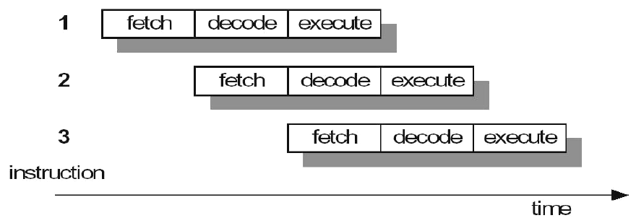
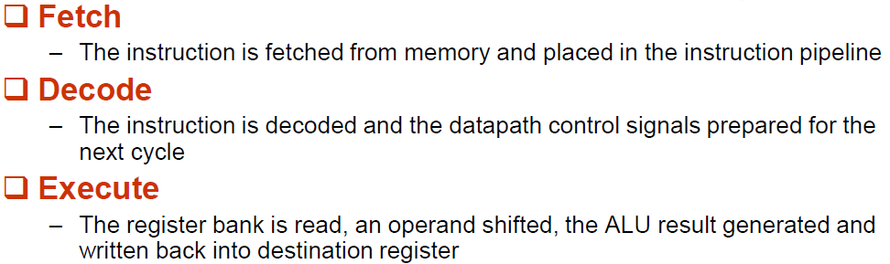
3-Stage pipeline architecture
At any time slice, 3 different instructions may occupy each of these stages, so the hardware in each stage has to be capable of doing independent operations.
When the processor is executing data processing instructions,
the latency = 3 cycles and the throughput = 1 instruction/cycle
3

Slide 4
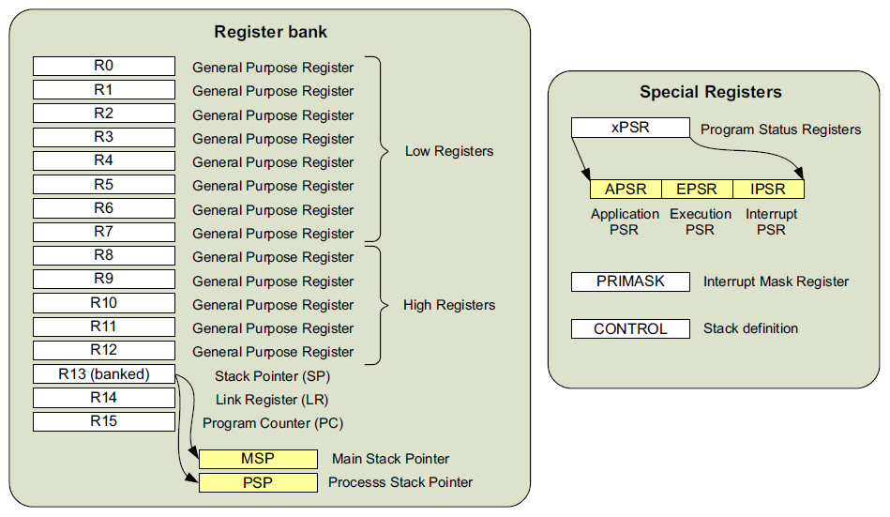
Processor Core Registers

Slide 5
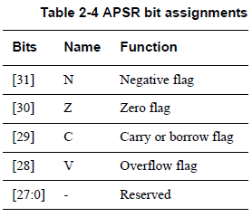
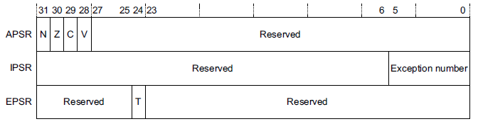
Program Status Register
Application Program Status Register
Interrupt Program Status Register
Execution Program Status Register

Slide 6
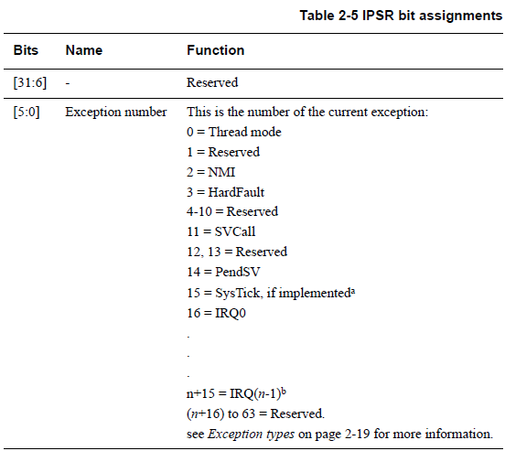
IPSR bit assignments

Slide 7
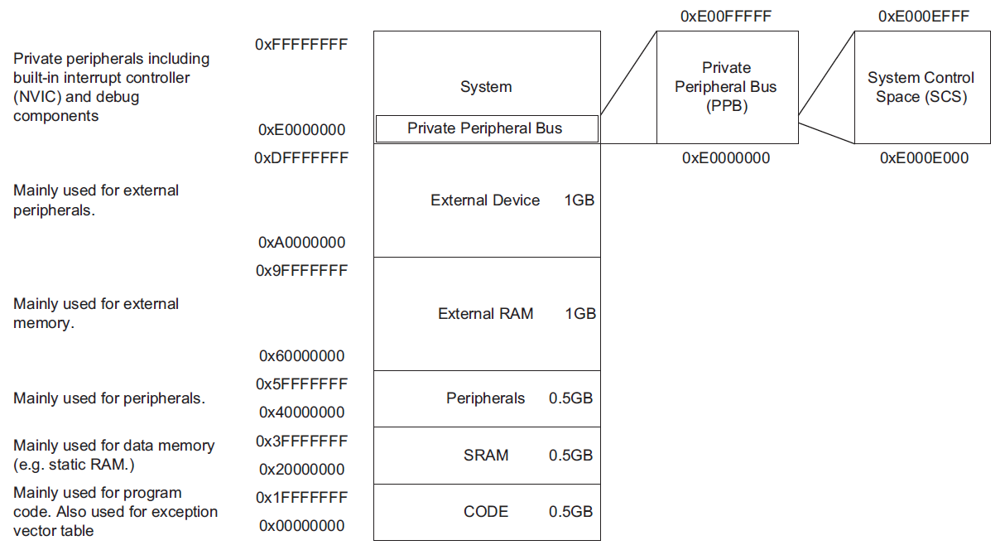
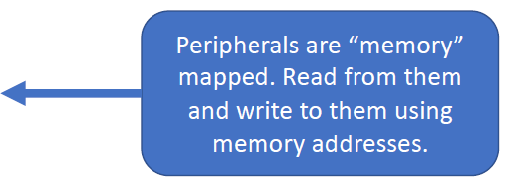
Cortex-M0 Memory Map
7

Slide 8
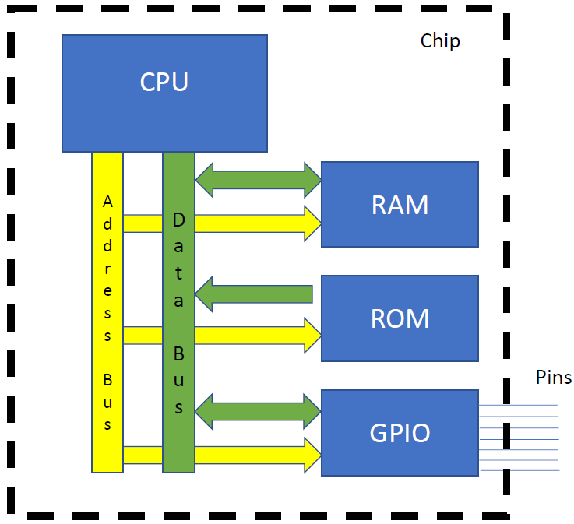
General MCU Interfacing
CPU needs to talk to RAM
(read/write variables)
Read from ROM
One bus to drive the address
One bus to send/receive data
Want to talk to other stuff too!
Drive 1/0 on pins
Read 1/0 from pins
How?
8

Slide 9
Perform I/O operations
There are two complementary approaches to performing I/O operations:
Port-mapped I/O uses special machine instructions, which are designed
specifically for I/O operations. The memory address space and the I/O device
address space are independent of each other. For example, Intel x86 processors use IN and OUT instructions to read from or write to a port.
Memory-mapped I/O does not need any special instructions. The memory and
the I/O devices share the same address space. Each peripheral register or data
buffer is assigned to a memory address in the memory address space of the
microprocessor.
Memory-mapped I/O is performed by the native load and store instructions of the processor. Therefore, memory-mapped I/0 is a more convenient way to interface I/O devices. Cortex-M0 uses this approach.
9

Slide 10
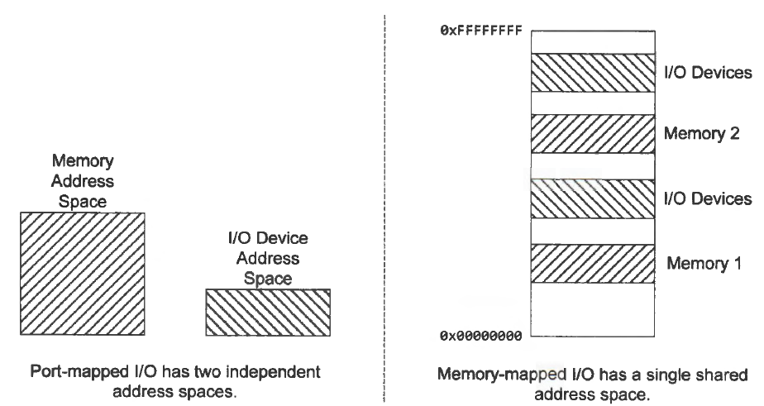
Port-mapped I/O vs Memory-mapped I/ O
10

Slide 11
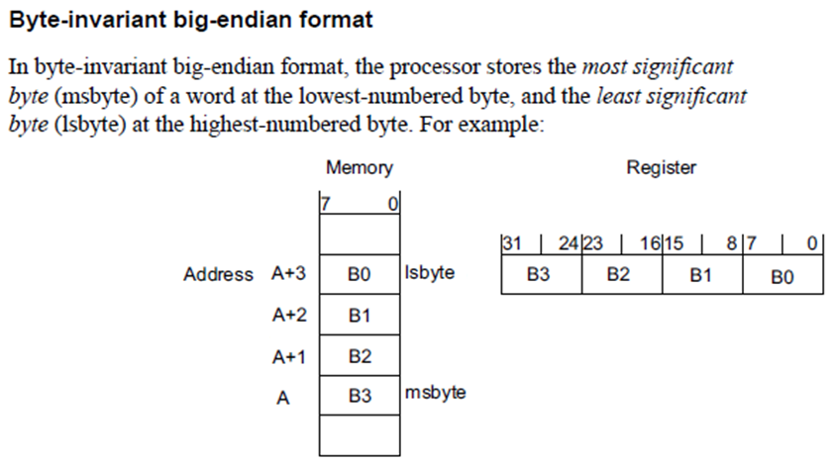
Big-endian format

Slide 12
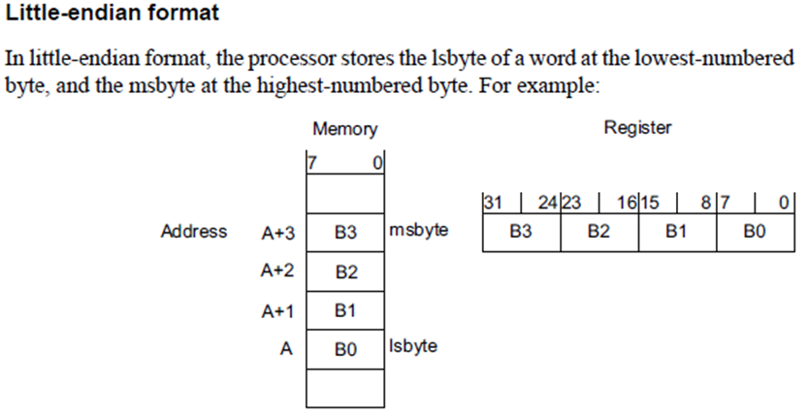
Little-endian format
ARM can be set up to access data in either little-endian or big-endian format, through they default to little-endian.

Slide 13
External Interrupts
External Interrupts handled by Nested Vectored Interrupt Controller (NVIC)
Tightly coupled with processor core
One Non-Maskable Interrupt (NMI) supported
Number of external interrupts is implementation-defined
Cortex-M0 supports up to 64 interrupts
INTNMI
NVIC
Cortex-Mx Processor Core
INTISR[0]
…
…
INTISR[N]
……
Cortex-Mx Integration Layer
13

Slide 14
Exception Handling
Exception types:
Reset
Non-maskable Interrupts (NMI)
Faults
PendSV
SVCall
External Interrupt
SysTick Interrupt
Exceptions processed in Handler mode (except Reset)
Exceptions always run privileged
Interrupt handling
Interrupts are a sub-class of exception
Automatic save and restore of processor registers (xPSR, PC, LR, R12, R3-R0)
Allows handler to be written entirely in ‘C’
14

Slide 15
Exception Handling Example
Higher Priority
IRQ1
IRQ2
IRQ3
Base CPU
Time
Core Execution
Foreground
ISR2
ISR1
ISR2
ISR3
Foreground
(ISR 2 resumes)
15

Slide 16
Reset Behavior
Main
5
4
Reset Handler
0x04
0x00
3
Reset Handler Vector
1
Initial value of MSP
r13 (MSP)
2
A reset occurs (Reset input was asserted)
Load MSP (Main Stack Pointer) register initial value from address 0x00
Load reset handler vector address from address 0x04
Reset handler executes in Thread Mode
Optional: Reset handler branches to the main program
16

Slide 17
Exception Behaviour
Main
4
3
1
Exception Handler
2
Exception Vector
Exception occurs
Current instruction stream stops
Processor accesses vector table
Vector address for the exception loaded from the vector table
Exception handler executes in Handler Mode
Exception handler returns to main
17

Slide 18
Cortex-M0 Instruction Set
Memory access instructions
e.g., LDR, STR, …
General data processing instructions
e.g., ADDS, SUBS, BICS, MULS, …
Branch and control instructions
e.g., BL, BX, …
Miscellaneous instructions
e.g., MSR, MRS, …
Reading: Handouts / ARM_cortex_m0_Generic User Guide.pdf,
Chapter 3 page 3-1 ~ 3-60
18

Slide 19
A Simple Cortex-M0 assembly program
; FirstArm.s - A simple ARM assembly program
; The semicolon is used to lead an inline documentation.
AREA FirstArm, CODE, READONLY
ENTRY
__main
; Load immediate values into registers R0 and R1
MOVS R0, #10 ; R0 = 10
MOVS R1, #20 ; R1 = 20
MOV R2, R0 ; R2 = R0
; Add the values in R0 and R1, store the result in R3
ADDS R3, R0, R1 ; R3 = R0 + R1 (R3 = 30)
ADD R2, R1 ; R2 = R2 + R1 (R2 = 30)
Here B Here ; Infinite loop to stop program execution
END ; End of assembly file
19

Slide 20
Some simple instructions
MOV Rd, #k ; Move an immediate value to register Rd
k is an 8-bit value ( 0~ 255 decimal number)
Example:
MOV R5, #53 ; immediate value in decimal
MOV R9, #0x27 ; immediate value in hexadecimal
MOV R3,#2_11101100 ; immediate value in binary
With MOV, the immediate value is limited to an 8-bit value. What if we want to move any 32-bit value to a register?
LDR Rd, =32-bit immediate
Example:
LDR R5, =0x11223344
20

Slide 21
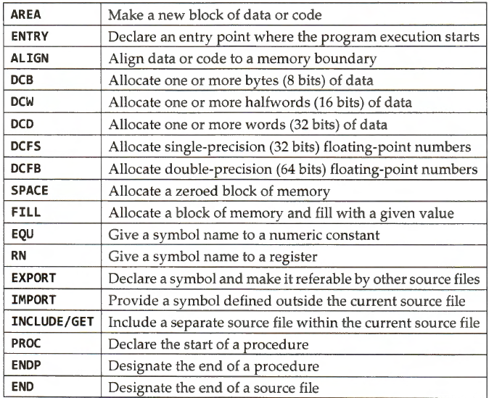
Assembly Directives
Instructions (e.g. ADD, MOV) tell the CPU what to do, while Assembly directives tell the assembler what to do.
21

Slide 22
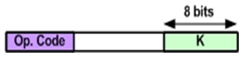
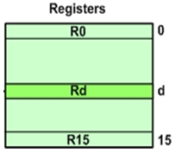
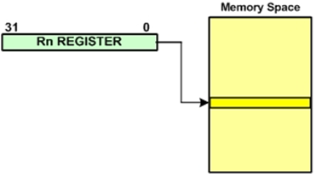
Some Arm addressing modes
Immediate
MOV R1, #0x25
ADD R6, R6, #0x40
Register addressing
MOV R2, R4
ADD R3, R2, R1
Register indirect (indexed)
STR R5, [R6]
; store the content of R5 into the memory location
; pointed to by R6
LDR R10, [R3]
; load R10 with the content of memory location
; pointed to by R3
22

Slide 23
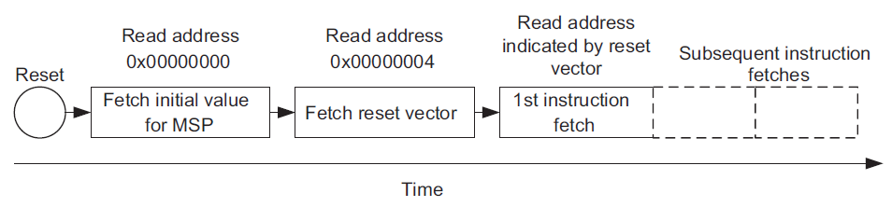
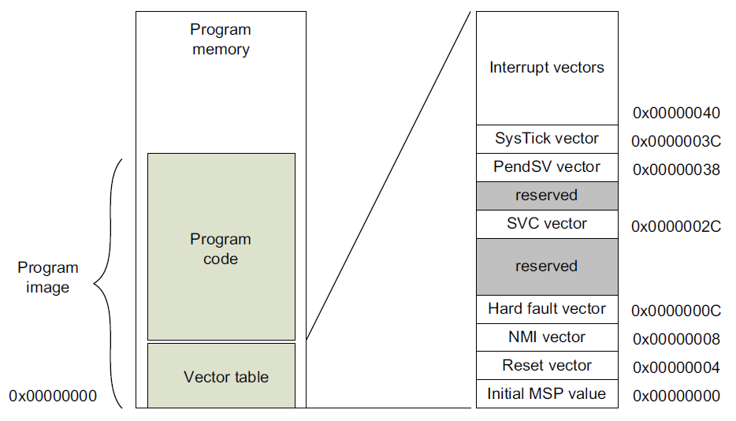
Are we done?
When an MCU is powered up, it will be reset first. (See p.16)
In the reset sequence, the processor obtains the initial MSP value and reset vector, and then it executes the reset handler.
23

Slide 24
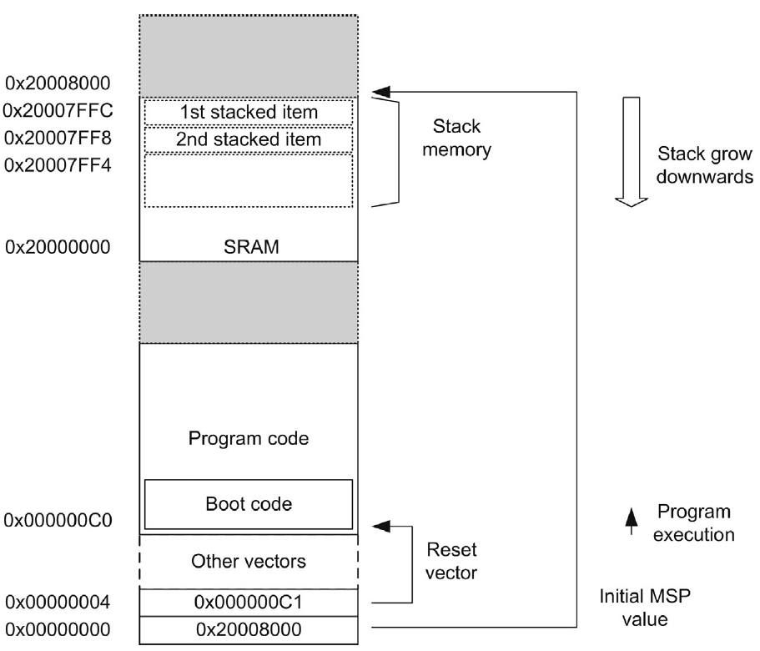
An Example of MSP and Initialization
24

Slide 25
A Modified Cortex-M0 assembly program
; FirstArm.s - A modified ARM assembly program
; Vector Table Mapped to Address 0 at Reset
AREA RESET, DATA, READONLY
EXPORT __Vectors
__Vectors
DCD 0x20008000 ; stack pointer value when stack is empty
DCD Reset_Handler ; reset vector
AREA FirstArm, CODE, READONLY
ENTRY
Reset_Handler PROC
EXPORT Reset_Handler
LDR R0, =__main
BX R0
ENDP
__main PROC
( …… code from previous slide )
Here B Here ; Infinite loop to stop program execution
ENDP
END ; End of assembly file
25

Slide 26
Defining Constant Values
DCB allocates bytes of memory & initializes them.
MYVALUE DCB 5
FIBO DCB 1, 1, 2, 3, 5, 8
MY_MSG DCB “Hello World!”
DCW allocates a half-word
MYVALUE DCW 0x5425
DCD allocates a word of memory
MYDATA DCD 0x20000000
name EQU value
COUNT EQU 0x25
MOV R1, #COUNT
GPIOA_ODR EQU 0x4001080C
26

Slide 27
Any Better Way?
A better way to run FirstArm.s on NUC140, we need a startup code
startup_NUC100Series.s
The Cortex-M0 startup code is a crucial piece of software that executes immediately after a system reset or power-on.
preparing the microcontroller for the execution of the main application. It is typically written in assembly language or a combination of assembly and C.
The startup code is often provided by microcontroller vendors as part of their development tools or software packages (e.g., CMSIS).
It works in conjunction with the linker script, which defines the memory layout and placement of different code and data sections in the microcontroller's memory.
27

Slide 28
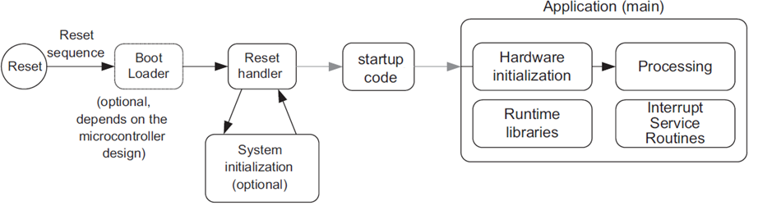
Power on a Microcontroller
Most modern microcontrollers have on-chip flash memory to hold the compiled program. Programs written in assembly or in C must be compiled and programmed to the flash memory.
After the flash memory is programmed, the program is then accessible by the processor, and the running flow is as outlined below.
28

Slide 29
With startup_NUC100Series.s
; FirstArm.s - A simple ARM assembly program
AREA FirstArm, CODE, READONLY
EXPORT __main
__main PROC
; Load immediate values into registers R0 and R1
MOVS R0, #10 ; R0 = 10
MOVS R1, #20 ; R1 = 20
MOV R2, R0 ; R2 = R0
; Add the values in R0 and R1, store the result in R3
ADDS R3, R0, R1 ; R3 = R0 + R1 (R3 = 30)
ADD R2, R1 ; R2 = R2 + R1 (R2 = 30)
Here B Here ; Infinite loop to stop program execution
ENDP
END ; End of assembly file
29

Slide 30
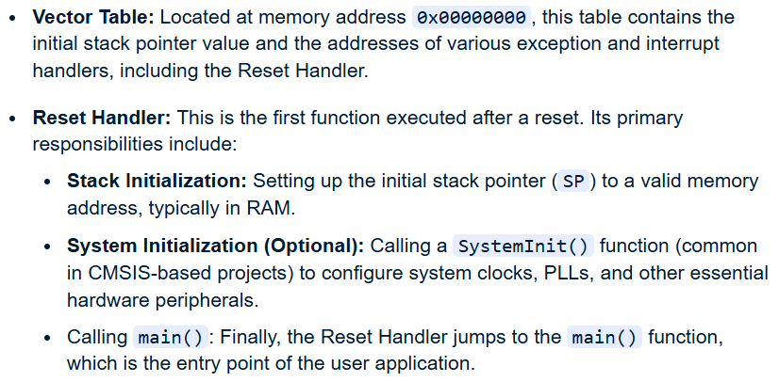
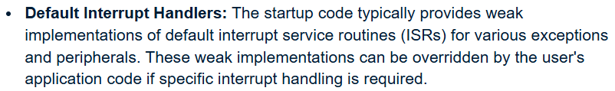
Exploring the startup code
Key components and functions of the Cortex-M0 startup code include:
30

Slide 31
Example: Search for the max value in a list
; Search for the max value in a list. The max value is stored in register R1
COUNT RN R0 ; COUNT is the new name of R0
MAX RN R1 ; MAX is the new name of R1
AREA MaxVal_1D, DATA, READONLY
MYDATA DCD 69, 87, 96, 45, 75
AREA MaxVal, CODE, READONLY
EXPORT __main
__main PROC
MOVS COUNT, #5 ; the size of the list is 5
MOVS MAX, #0
LDR R2, =MYDATA ; R2 stores the address of the first data
AGAIN LDR R3, [R2] ; load R3 with content at address pointed by R2
CMP MAX, R3 ; compare MAX with R3
BHS CONT ; if MAX >= R3, branch to CONT
MOV MAX, R3
CONT ADDS R2, R2, #4 ; increase R2 for the next word
SUBS COUNT, COUNT, #1 ; decrease COUNT
BNE AGAIN ; branch AGAIN, if COUNT is not zero, that is Z =0.
Here B Here ; Infinite loop to stop program execution
ENDP
END
31

Slide 32
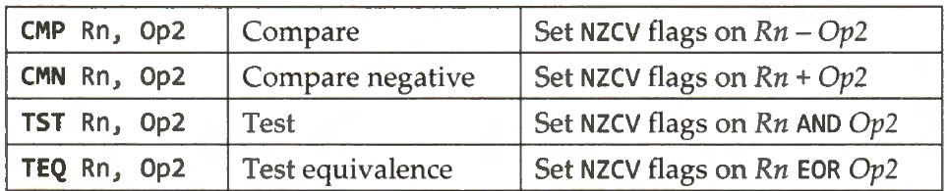
Data Comparison
CMP sets the flags the same way as SUBS. But does not store the result of subtraction. So, it suits for comparing.
CMP r0, #3 ;Compare r0 with 3
CMP r0, r1 ;Compare r0 and r1
CMN r0, # -10 ;Compare r0 with -10
32

Slide 33
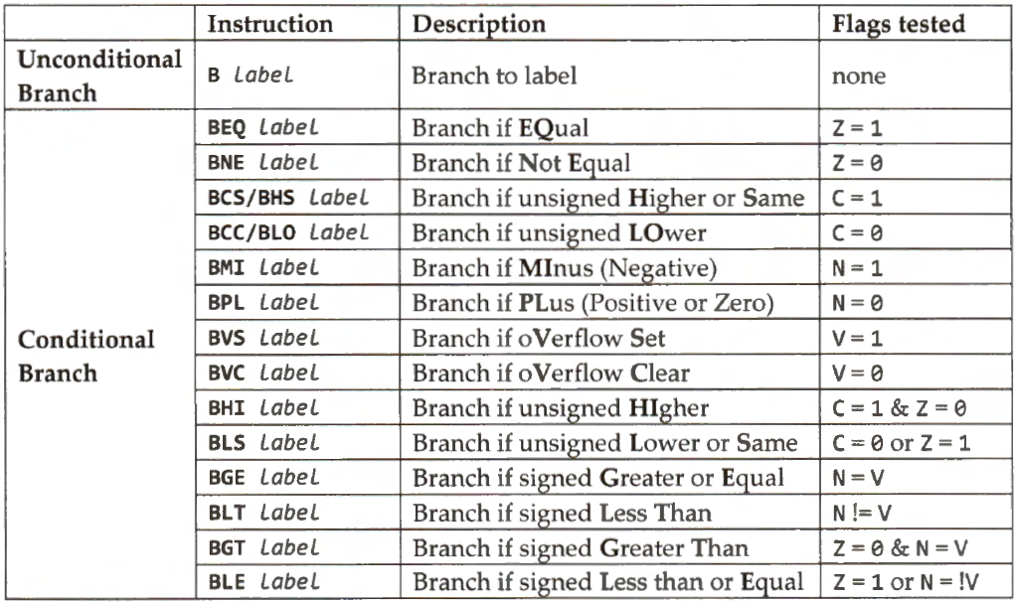
Branch Instructions
33

Slide 34
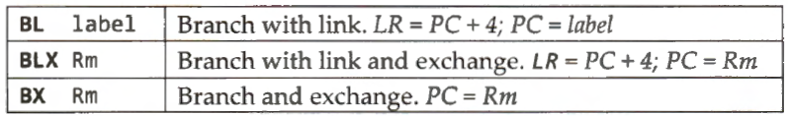
Branch Instructions that call a subroutine
" BL label" instruction copies the memory address of the instruction immediately after the BL instruction into the link register (r14), and then branches to the instruction addressed by the label.
" BLX Rm" first places the address of the next instruction after the BLX instruction into the link register and then branches to the address held in Rm.
"BX Rm" is like " BL label" except that the target instruction address is saved in register Rm.
34

Slide 35
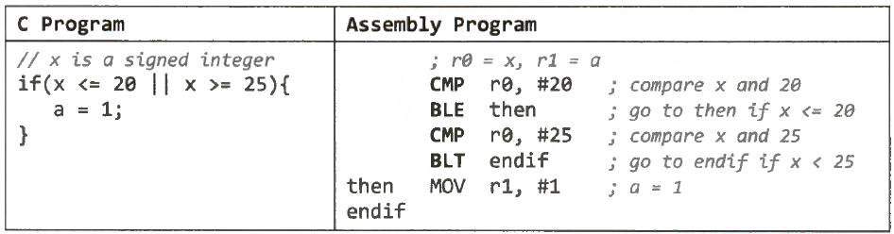
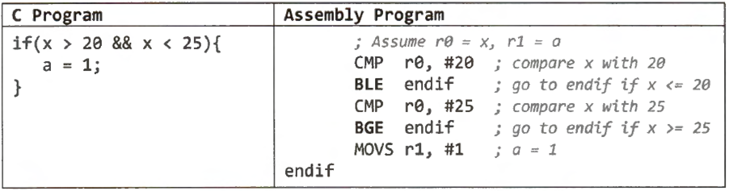
If-then Statement
With a compound logical OR expression.
With a compound logical AND expression.
35

Slide 36
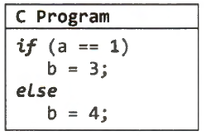
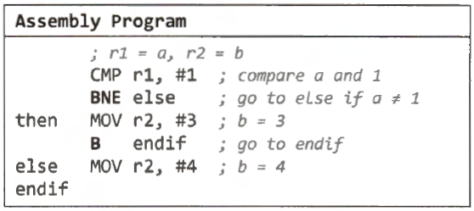
If-then-elase Statement
36

Slide 37
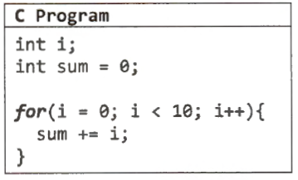
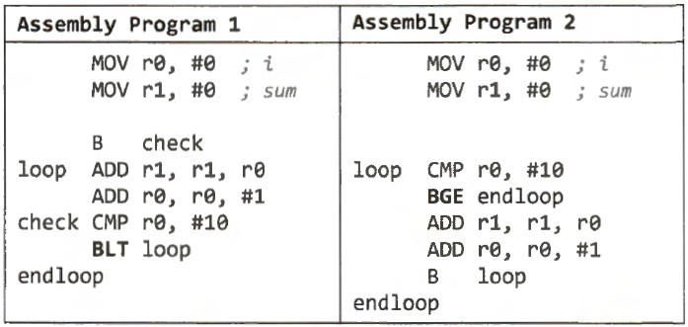
For Loop
37

Slide 38
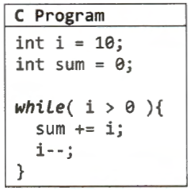
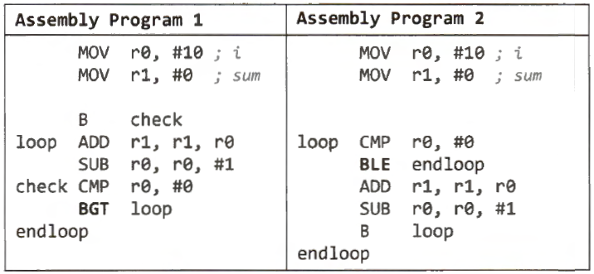
While Loop
38

Slide 39
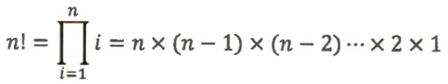
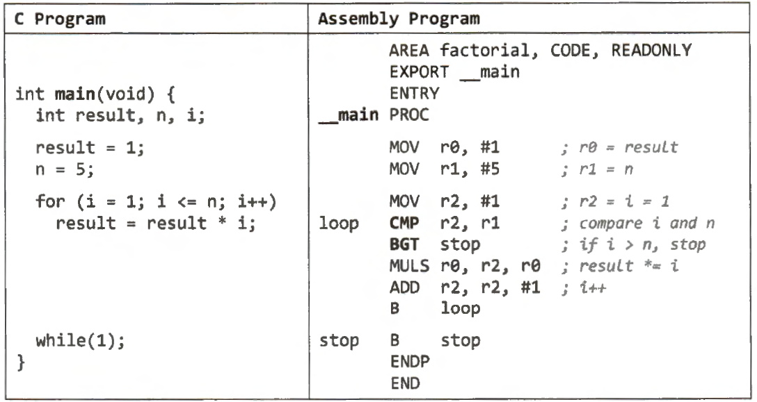
Example: Factorial Numbers
39

Slide 40
Example: Division by repeated subtractions
AREA Division, CODE, READONLY
EXPORT __main
__main PROC
LDR R0, =2012 ; R0 = 2012 (numerator)
; it will contain remainder
MOV R1, #10 ; R1 = 10 (denominator)
MOV R2, #0 ; R2 = 0 (quotient)
L1 CMP R0, R1 ; compare R0 to R1 to see if less than 10
BLO FINISH ; if R0 < R1, jump to finish
SUBS R0, R0, R1 ; R0 = R0 – R1 (division by subtraction)
ADDS R2, R2, #1 ; R2 = R2 + 1 (quotient is increased)
B L1
FINISH B FINISH
ENDP
END
40

